Slide 1
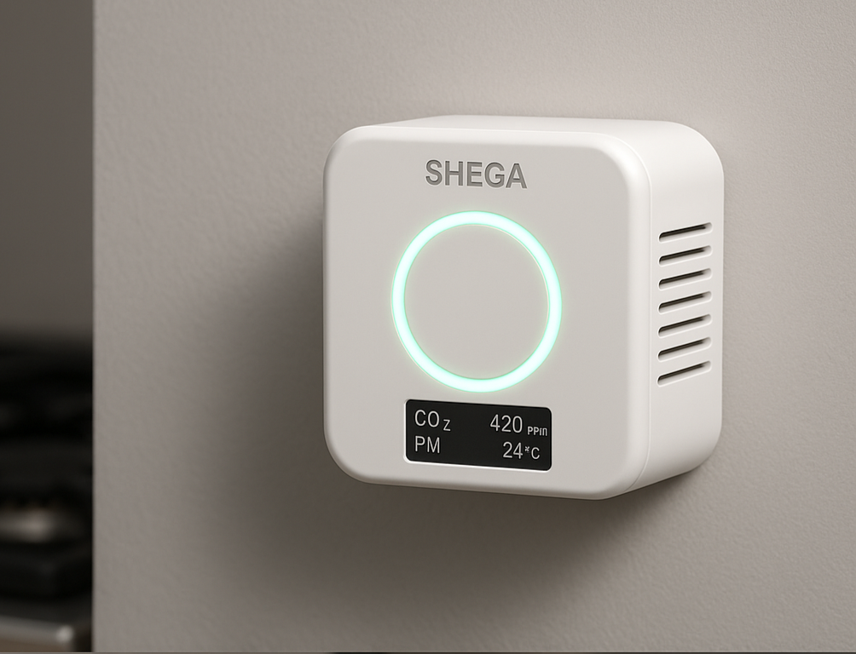
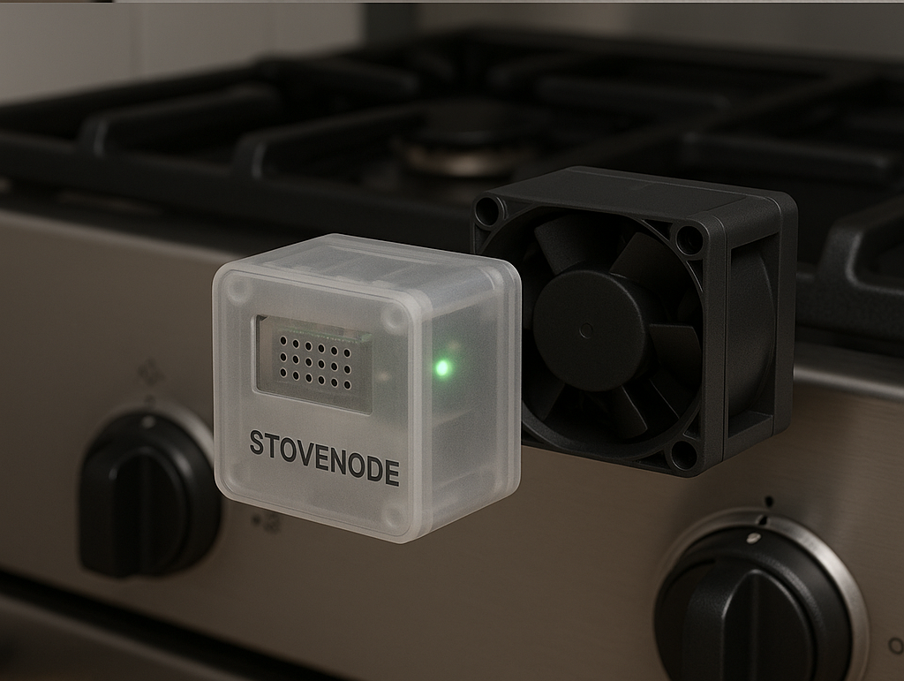
SHEGA – Smart Home Environmental Guardian Assistant
CO₂, CO & Smoke Monitoring + Stove Safety
Sebah Tewodros Tesfatsion| IoT Project | 2025

Slide 2
Problem Statement
Why Shega
Poor indoor air quality (CO₂, CO, smoke, particulate matter)
Cooking-related hazards (overheating stoves, fires)
Checking stove status online

Slide 3
Project Objectives
- Real-time indoor air quality monitoring
- Stove safety management with actuators (buzzer + fan)
- Centralized dashboard for control & visualization
- Data logging (MongoDB )
- AI-powered assistant

Slide 4
System Components
- AirNode (CO₂, CO, PM, Temp, Humidity, Buzzer)
- StoveNode (Thermocouple, LED, Fan)
- MQTT Broker (HiveMQ)
- Node.js + Express Server
- MongoDB Database
- Dashboard (Node-RED + Next.js)
- RAG Assistant (Python + Flask +TF-IDF +Phi-3 Min)

Slide 5
Edge Devices
- AirNode: ESP32 + DHT22 + SCD30 (CO₂) + ZE03-CO (CO) + PMS5003 (PM)+Buzzer
- StoveNode: ESP32 + Thermocouple (MAX31855)+ Fan
- Simulated via WokWi or/and Node.js
- Identified with Home ID + Device ID

Slide 6
Communication Layer
- MQTT Protocol with Mosquitto broker
- Example topics:
• shega/airnode/data → sensor readings
• shega/stovenode/status → stove state
• shega/stovenode/control → actuators
• shega/alerts → emergencies
- Secure broker with username/password

Slide 7
Backend & Data Management
- Node.js + Express REST API
- Functions:
• Receive MQTT messages
• Save telemetry in MongoDB
• Provide APIs for dashboard
• Trigger alerts
- Data stored in JSON +

Slide 8
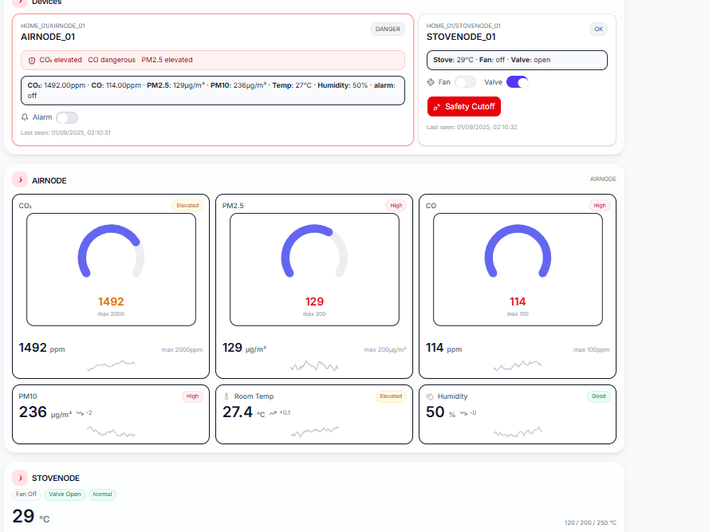
Dashboard
- User Views:
• Real-time gauges (CO₂, CO, PM, Temp)
• Stove status & control
• Historical charts
• - Admin Views:
• All houses + all devices
- Built with Next.js + recharts

Slide 9
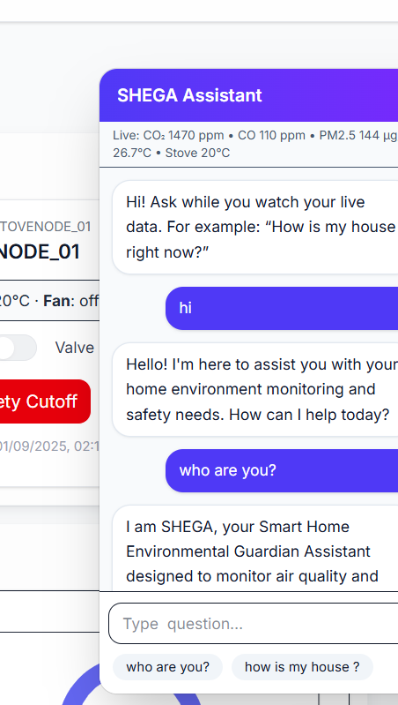
Powered RAG Assistant
Bilingual RAG Assistant – answers in Amharic & English
Combines telemetry + knowledge base for context
TF-IDF + cosine similarity for fast document retrieval
Local LLM via Ollama (Phi-3 Mini / TinyLlama / Llama2) for generation
Flask API + Next.js dashboard with live streaming responses
Knowledge Base: JSON (100+ entries)

Slide 10
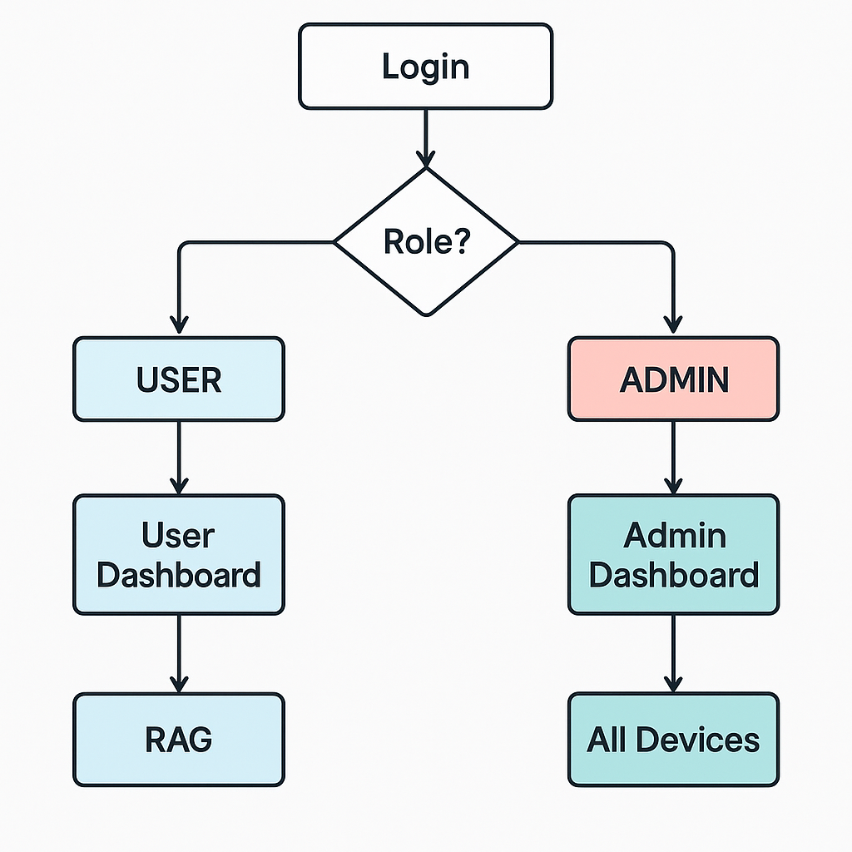
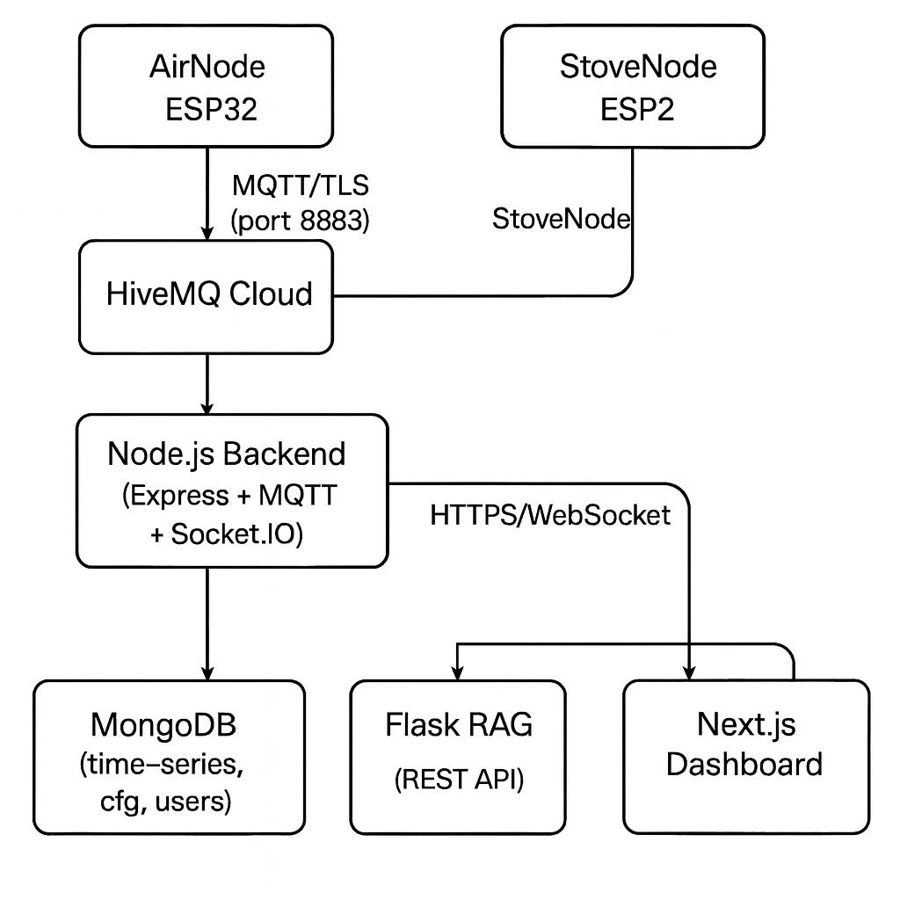
UX flow
Data flow

Slide 11
Implementation Details
- Technologies:
• Arduino (ESP32, WokWi)
• Node.js + Express
• Node-RED Dashboard
• MongoDB
• MQTT (HiveMQ)
• Python (RAG)
- Simulation: WokWi + Node.js device simulators

Slide 12
Demo / Screenshots
- MQTT topics in action
- Dashboard gauges
- Admin multi-house view
- RAG assistant answers )

Slide 13
Challenges & Solutions
- WokWi doesn’t support all sensors → Node.js simulators
- Secure MQTT connection → Broker authentication
- RAG assistant irrelevant answers → Improved prompt + intent detection

Slide 14
Future Improvements
- Mobile app integration
- SMS/Telegram alerts
- More sensors (VOC, formaldehyde)
- Smart appliance integration

Slide 15
Conclusion
- SHEGA provides:
• Safer kitchens
• Indoor air monitoring
• Bilingual user education
- Meets IoT project requirements (devices, sensors, actuators, MQTT, dashboard, AI)

Slide 16
Q&A
Thank you!
Any Questions?

